Slide 1
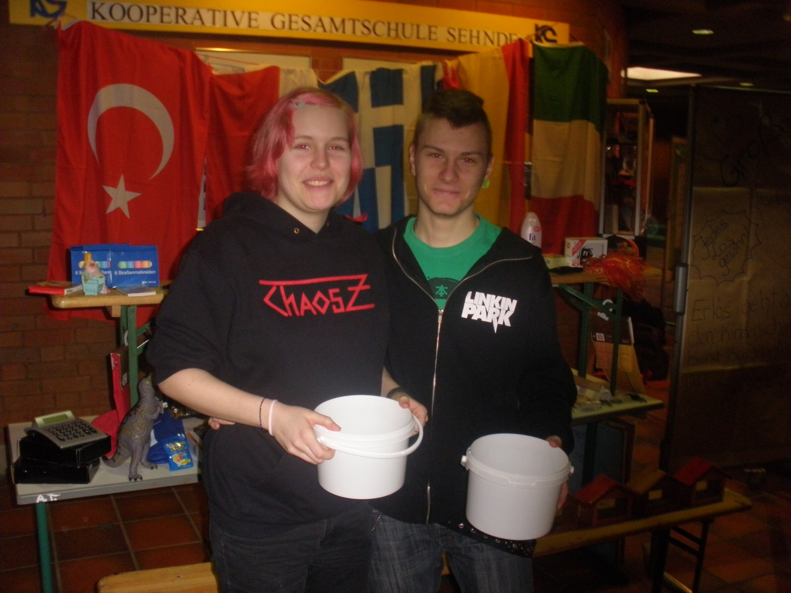
One Week of Solidarity

Slide 2
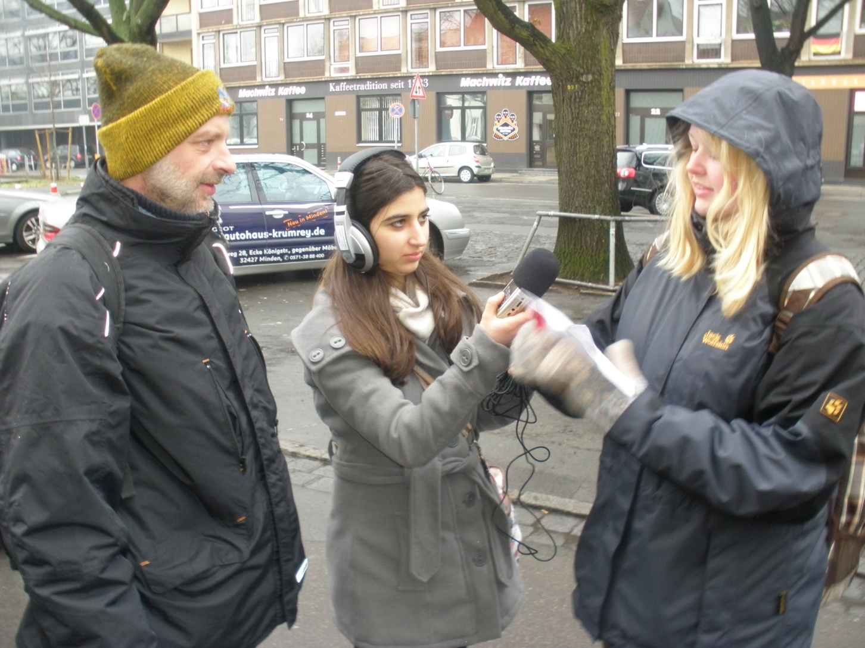
homelessness in Hanover

Slide 3
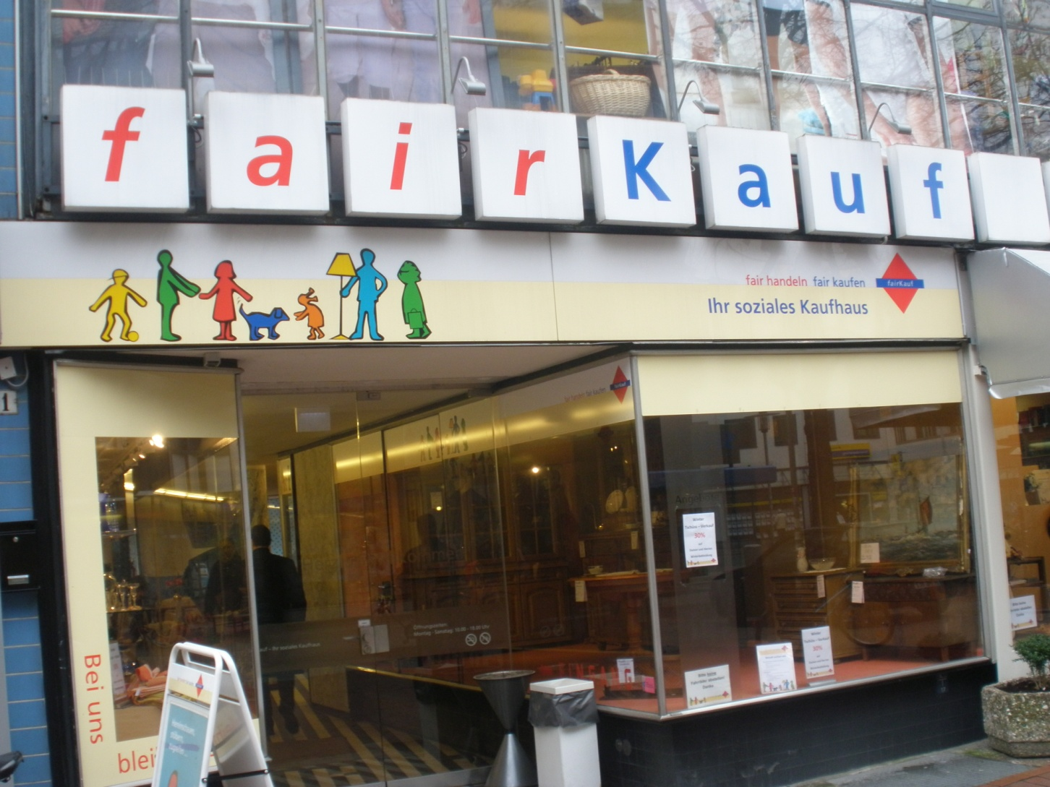
Fair Department Store

Slide 4
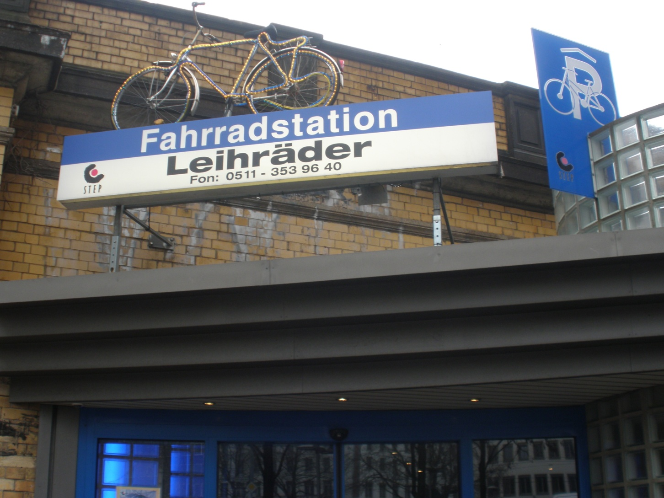
Alternattive Garage for Bikes

Slide 5
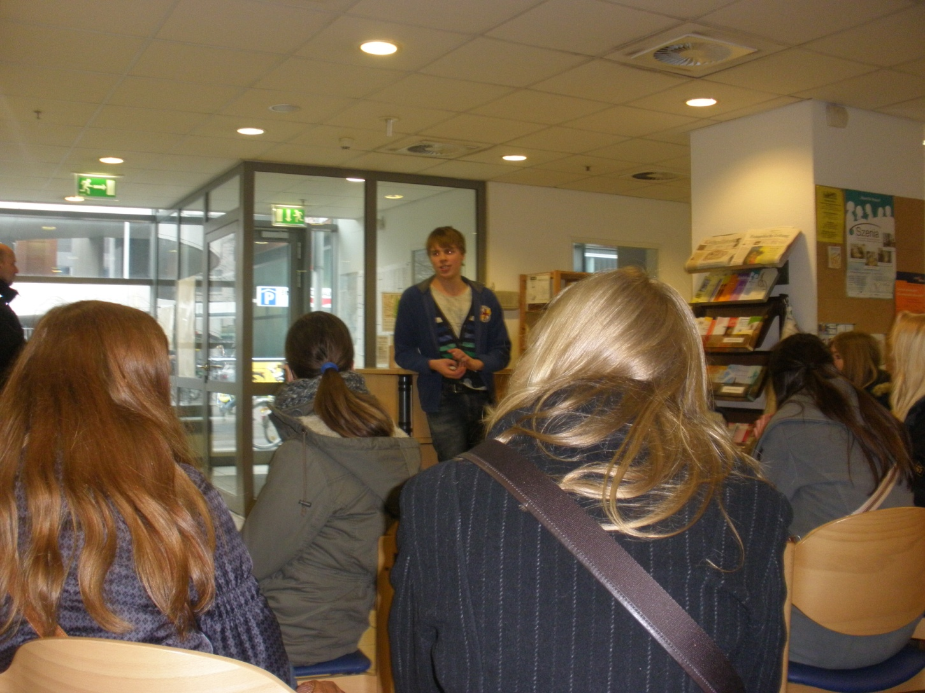
Traveller´s Aid

Slide 6
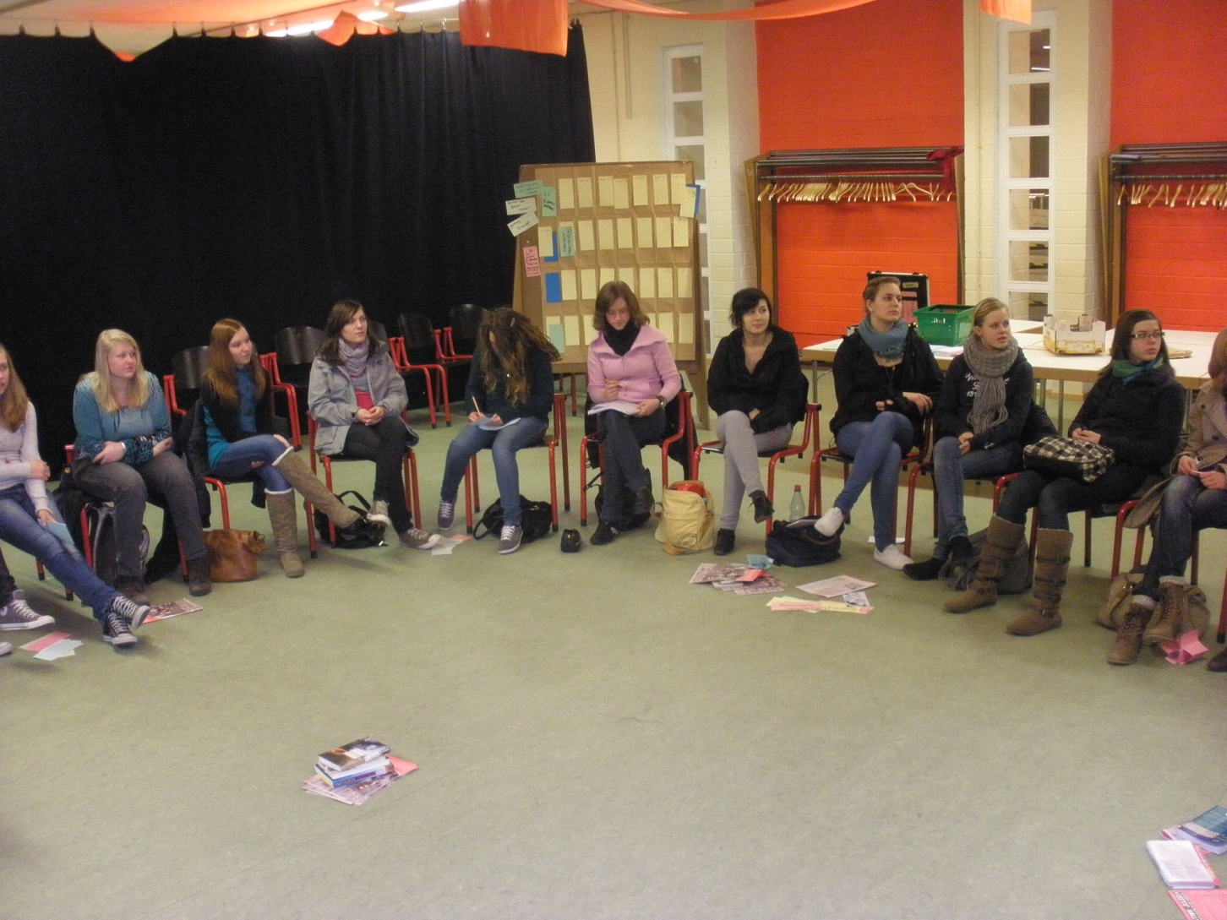
Education of Teenager Scouts

Slide 7
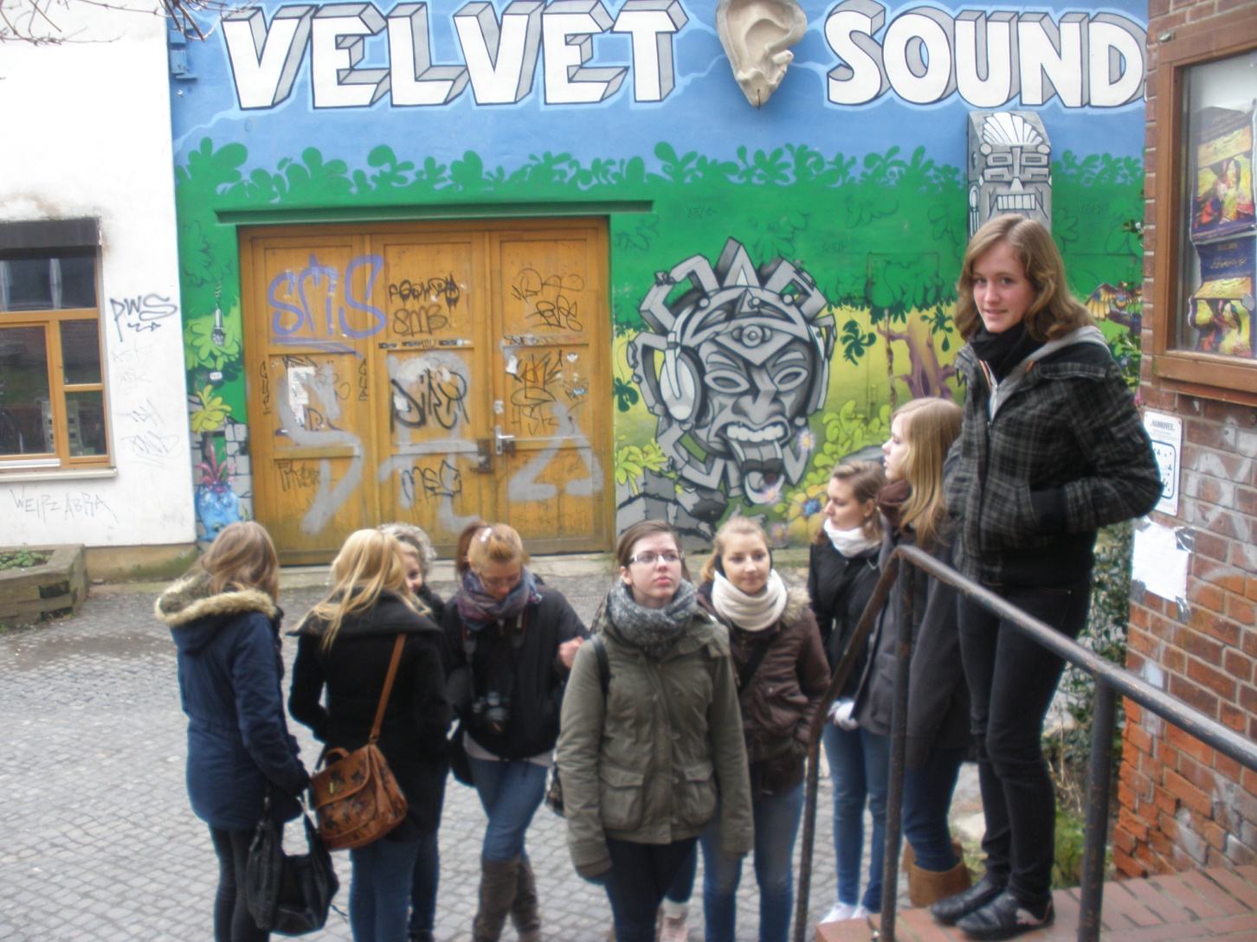
Cityproject “Faust“

Slide 8
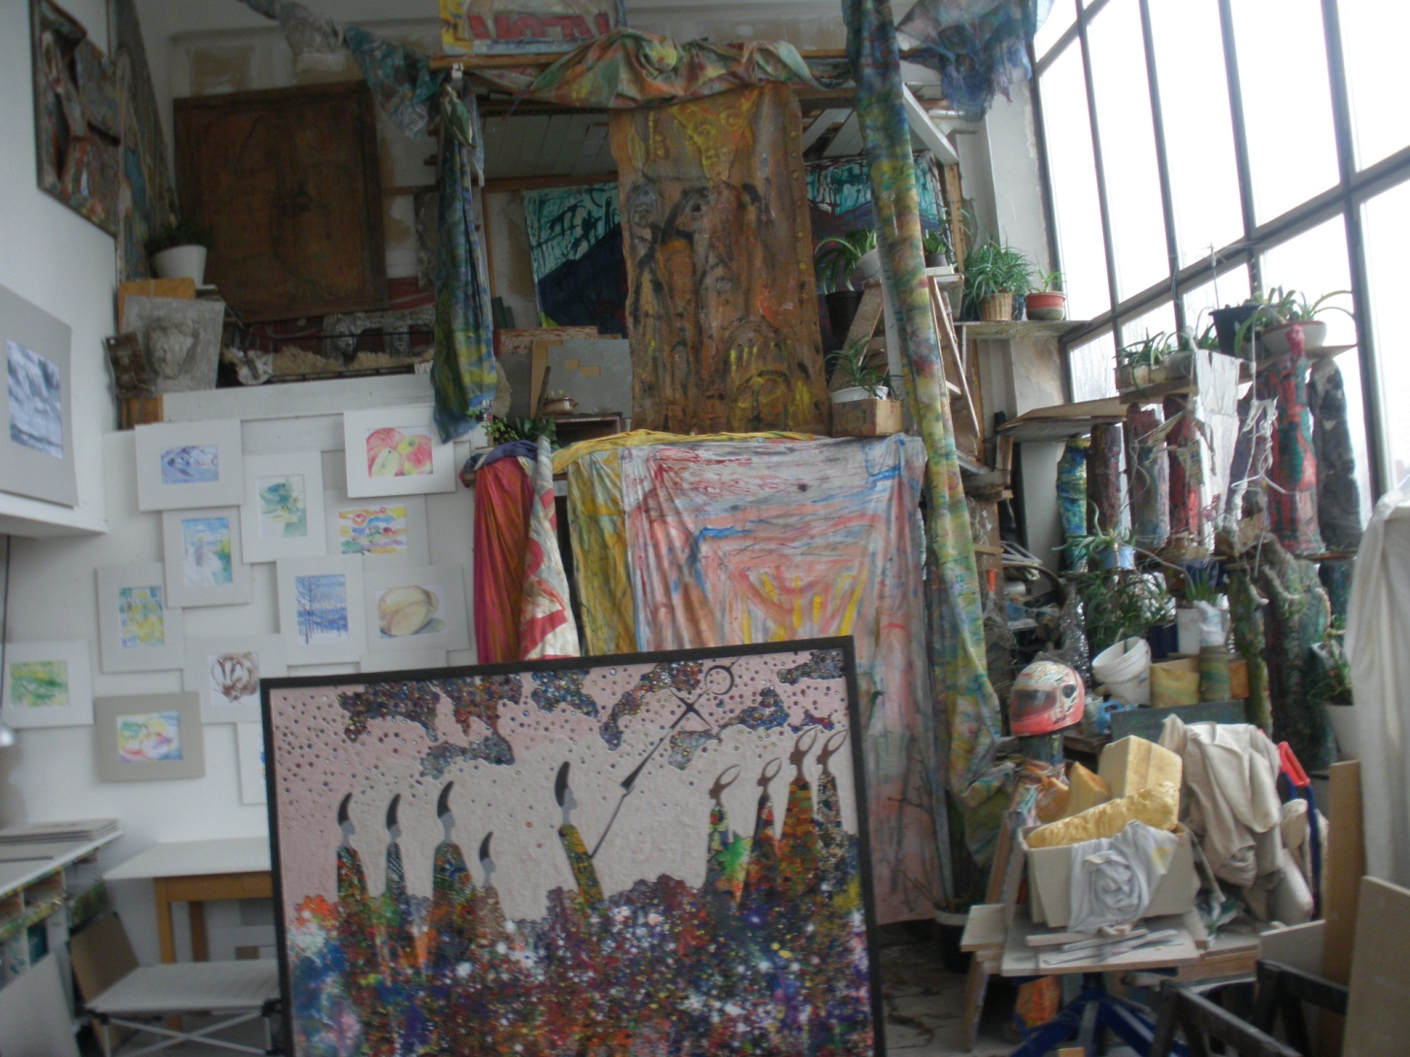
Common Atelier

Slide 9
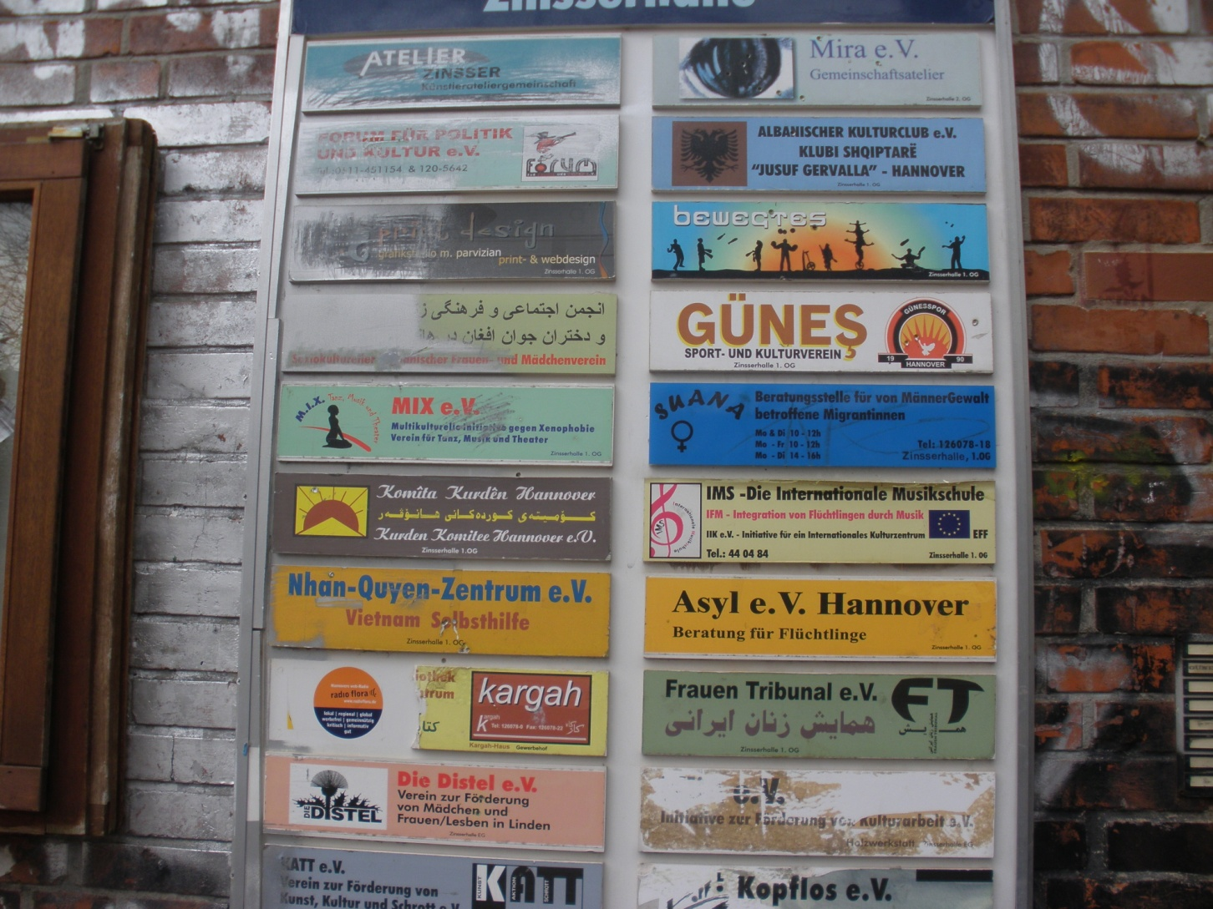
Many Projects in One building

Slide 10
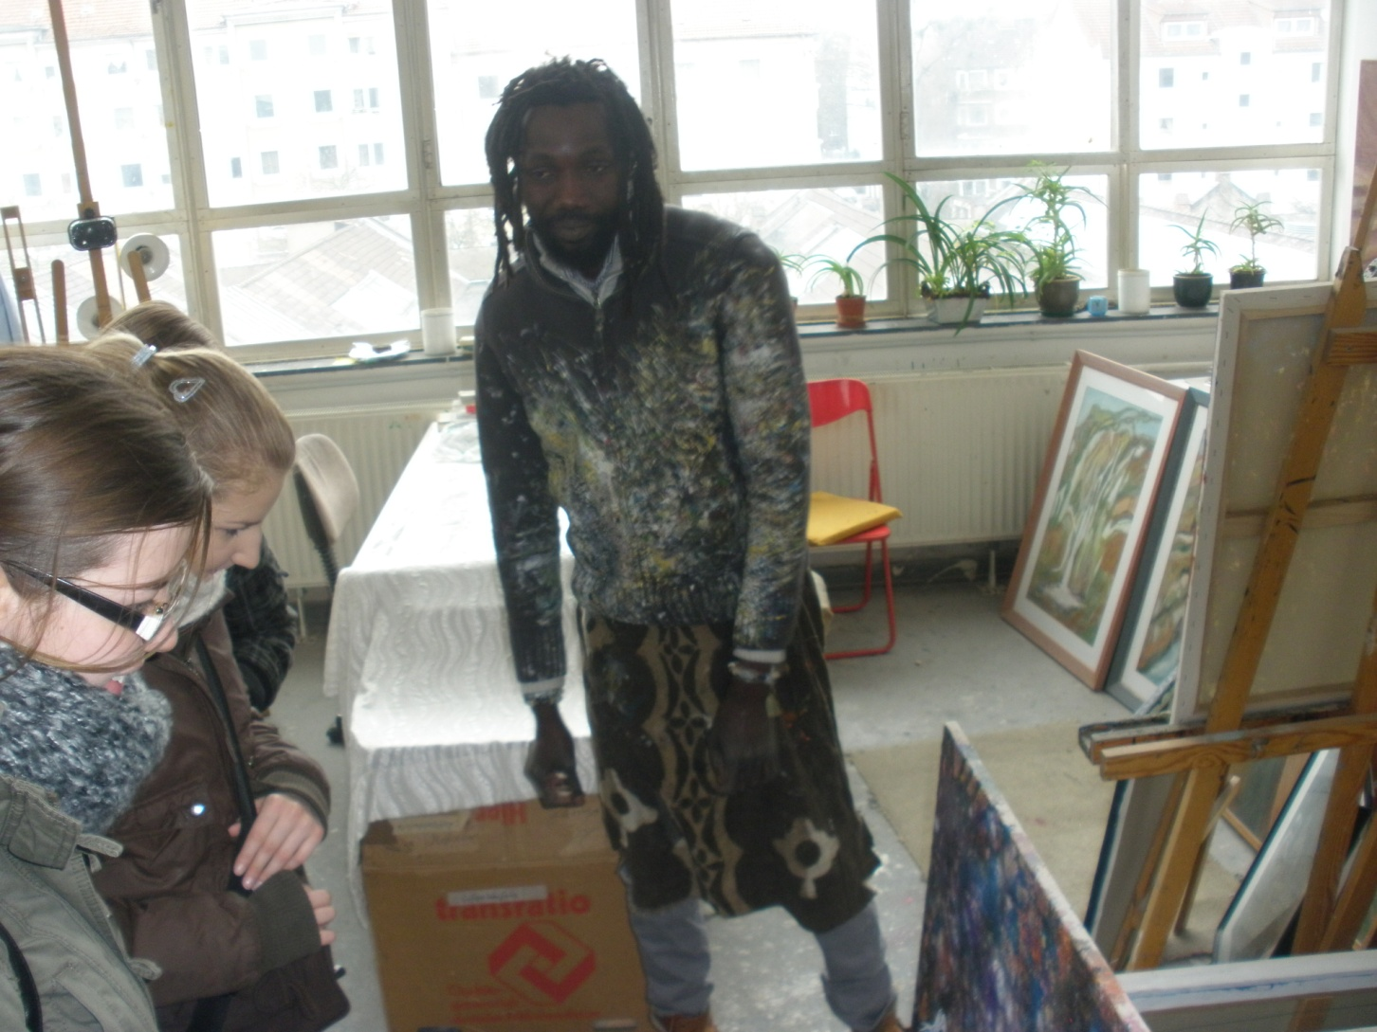
Art- a Way of Solidarity

Slide 11
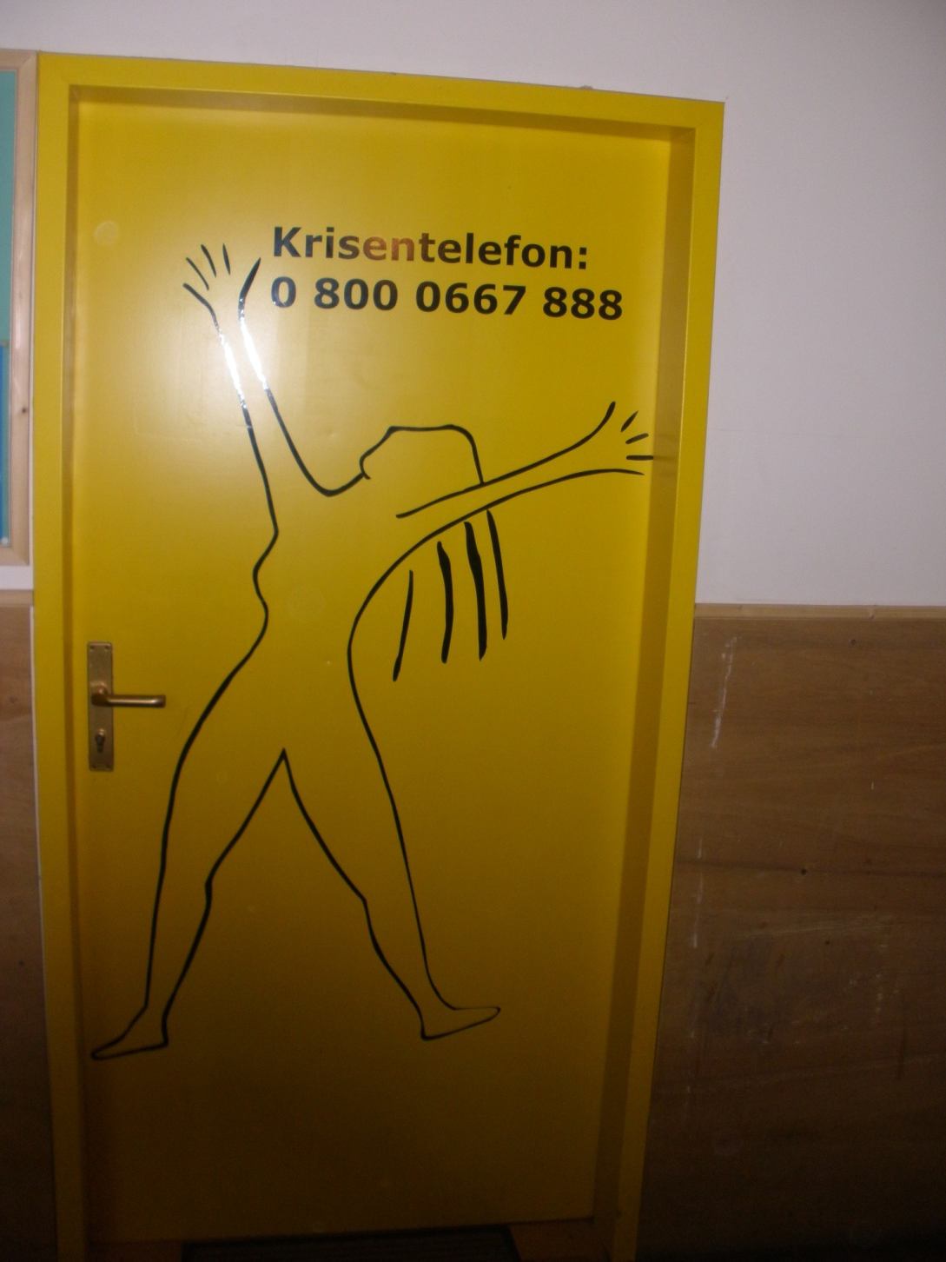
Help for surpressed women

Slide 12
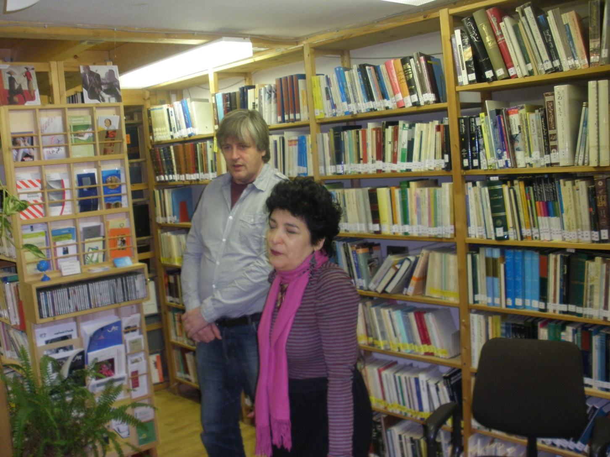
An “immgrated “ Library

Slide 13
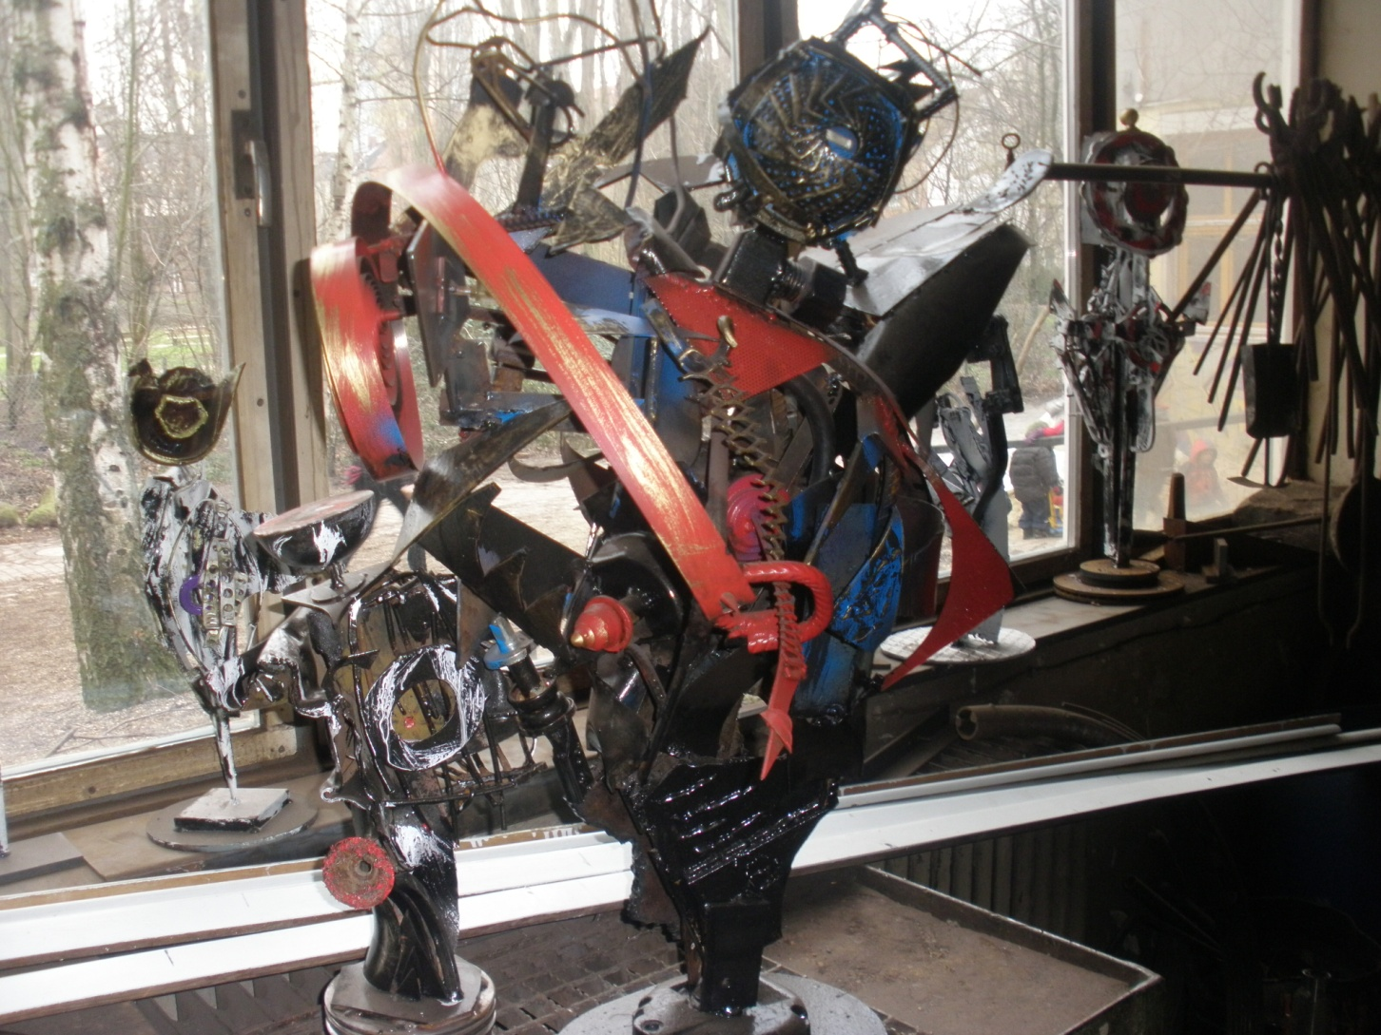
Art Made of Scrot

Slide 14
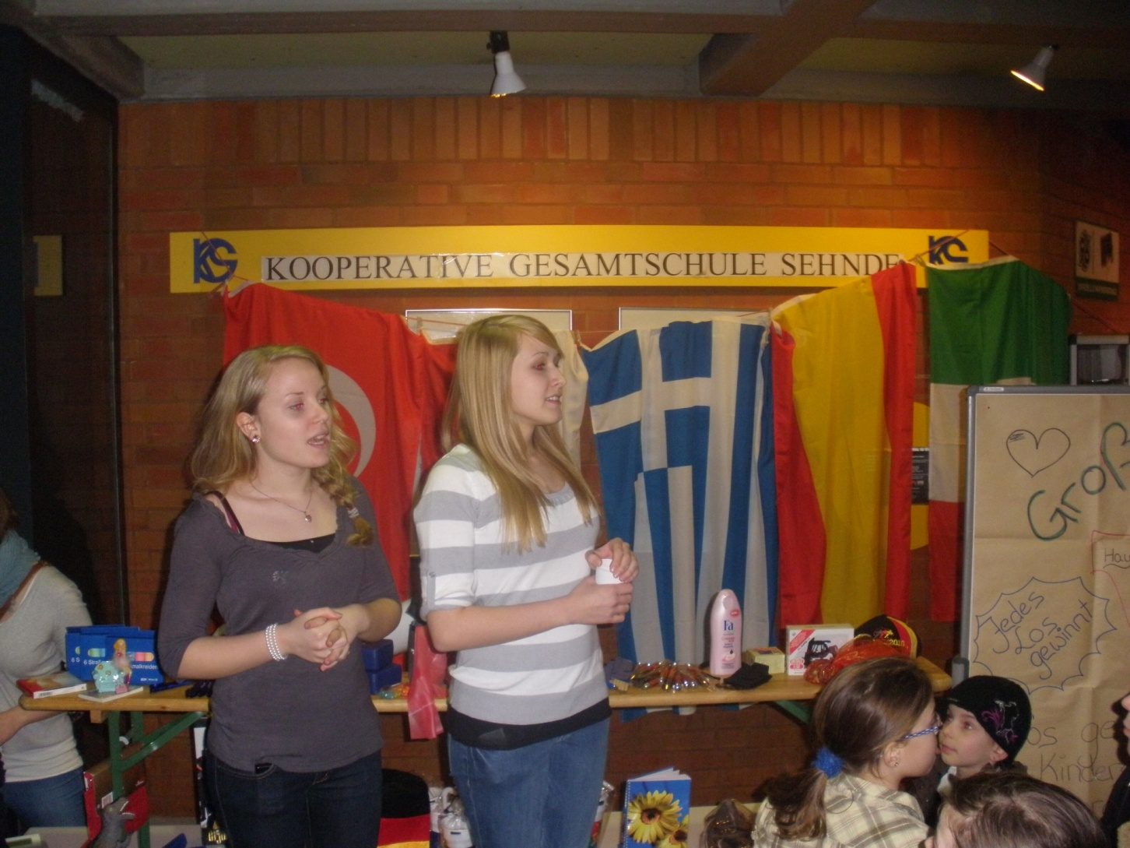
A Raffle for „Löwenherz“

Slide 15
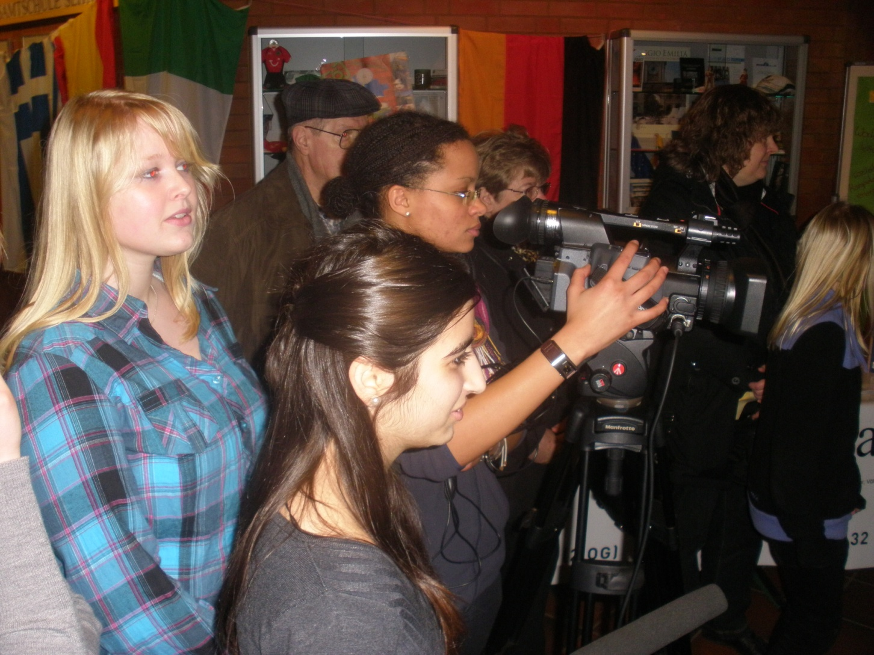
The Solidarity Day Reflected in the Media

Slide 16
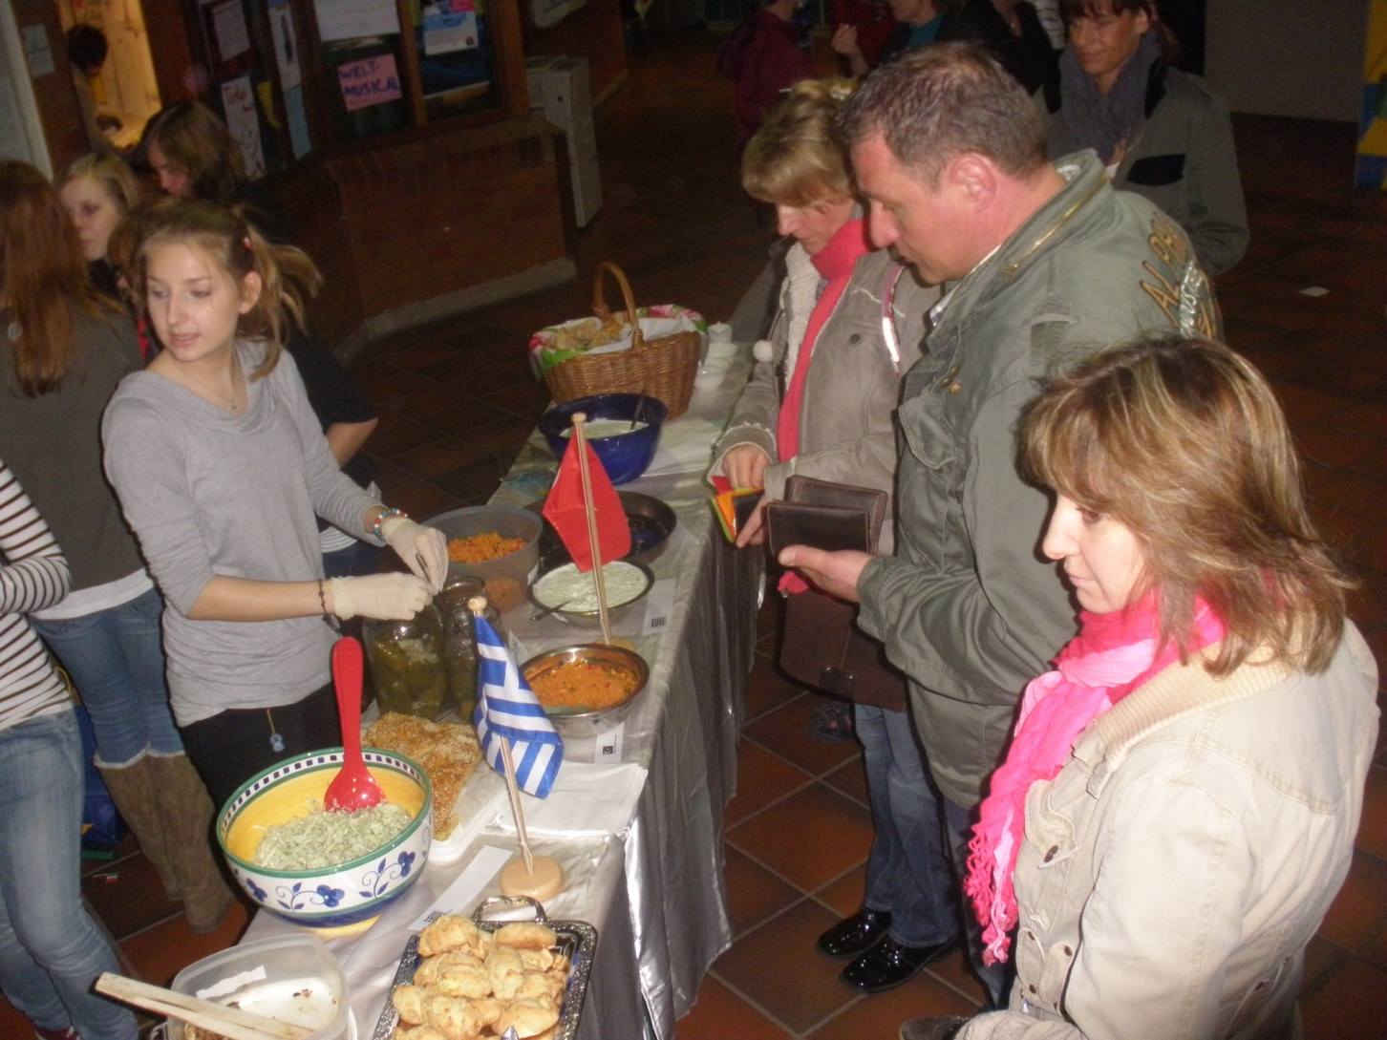
Six Countries – Six Meals

Slide 17
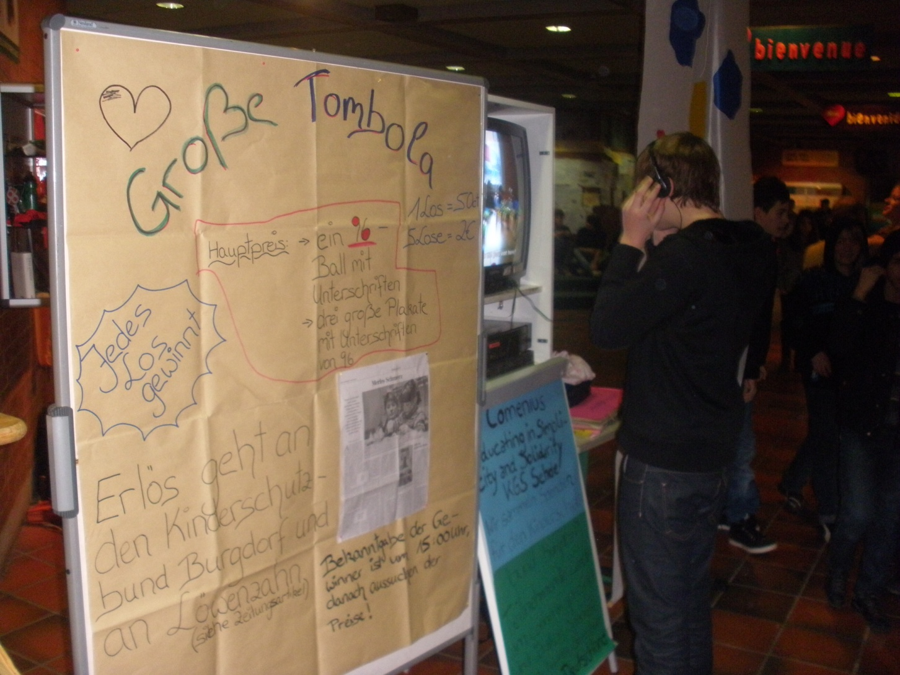
Löwenherz – Pocess of grieving for Children and Teenagers

Slide 18

Solidarity in the

